Slide 1
From Theory to Practice: How Mate Choice Enhances Reproductive Success
Meghan Martin-Wintle
¹San Diego Zoo Global & PDXWildlife

Slide 2
Compatibility and reproductive success
Current endangered species captive breeding match mates based on genetic goals
A genetically recommended pair must mate
Compatibility is not binary - a pair may mate but have suboptimal reproductive output
Compromise can occur at many levels (mating, offspring production, offspring maternal care and offspring viability):

Slide 3
Study Design
All potential mating partners were recommended from the SSP
Measured behaviors for 30 minutes
Preferred = >60% of mating behaviors performed toward one
Shift Door
Howdy Window
♂
♀
♂

Slide 4
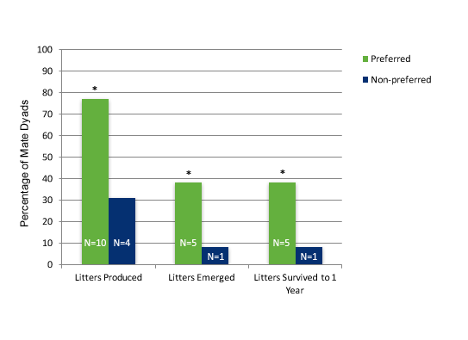
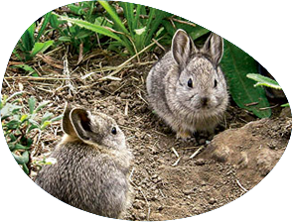
CB Pygmy Rabbit Female Mate Choice
(N=13)
(N=13)
Female pygmy rabbits mated to preferred males:
Were more likely to produce a litter (F1,26 = 15.89, p< 0.001)
Samples sizes were too low in the non-preferred group to determine statistical significance for litter emergence and survivorship
Had more kits in their litter (F1,14 = 65.05, p< 0.001)
Conservation Biology 26.4 (2012): 649-656

Slide 5
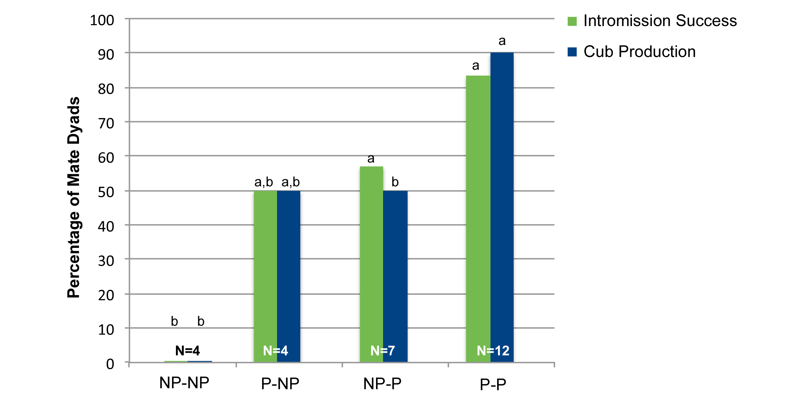
Giant Panda Mutual Mate Choice
Male
 | Nonpreferred | Preferred
Non preferred | 0% (0%) N = 4 | 57.1% (50%) N = 7
Preferred | 50% (50%) N = 4 | 83% (90%) N = 12
Female
% Intromission success (%Cub production)
Preferred♀-Preferred♂ pairings had the highest reproductive success and cub production
Nonpreferred♀- Nonpreferred ♂ pairings had the lowest success
Mixed preference pairings were resulted in intermediate success
Nature Communications 6, 2015

Slide 6
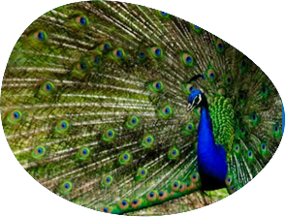
How mate choice may help endangered species breeding
Offering mate choice has been shown to enhance compatibility and reproductive success for many species
Mate choice is of interest to zoo and aquarium managers, there are many questions about:
How to offer choice, given species and facility differences
Assess choice, i.e., identify which individual is preferred

Slide 7
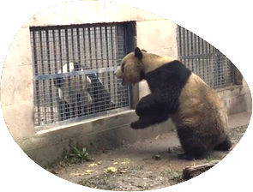
Male-Male Competition and Reproductive Success
Goals:
Does male-male competition increase courtship behavior?
Does male-male competition increase reproductive success?

Slide 8
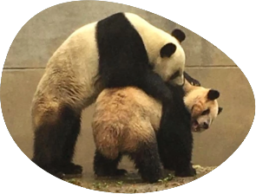
Male-Male Competition and Reproductive Success
2018 is final collection year
Male sexual behaviors seem to increase toward females after competition (data not analyzed)
Males given competition have 85% intromission success (N=13) vs. 58% (N=12)
Some evidence that male-male competition motivated previously non-mating males to mate (e.g. Tai Shan)

Slide 9
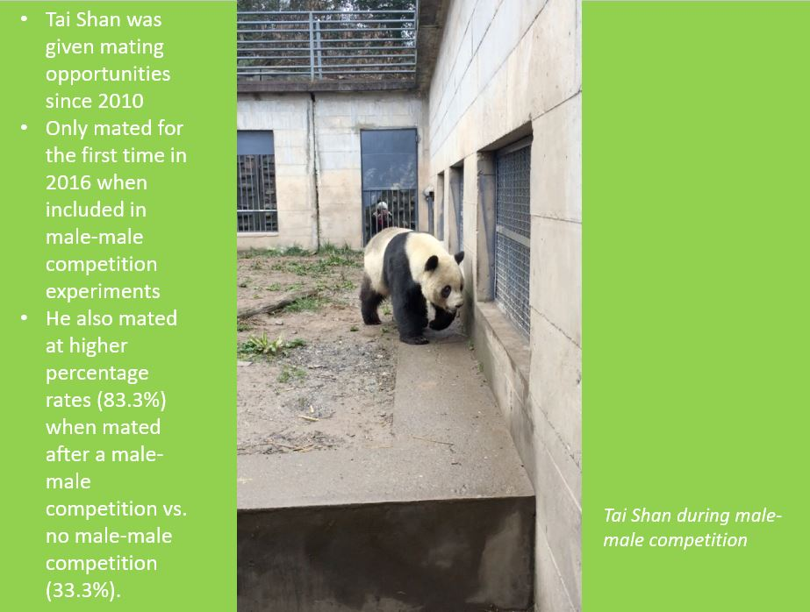

Slide 10
Future Directions
Alternative methods and designs could be used to assess choice
Alternative behavioral mechanisms may be important to breeding (e.g. male-male competition)
Critically examine the natural mating system and alter management to include these natural systems as much as possible
Expand to other species struggling to meet population goals

Slide 11
What We Have
Lots of disjointed records that currently get hand compiled (or R script) into one record per project
Behavioral recording
Observation Log for external environmental and husbandry information
Additional logs for tracking hormone data, fecal collections, etc.

Slide 12
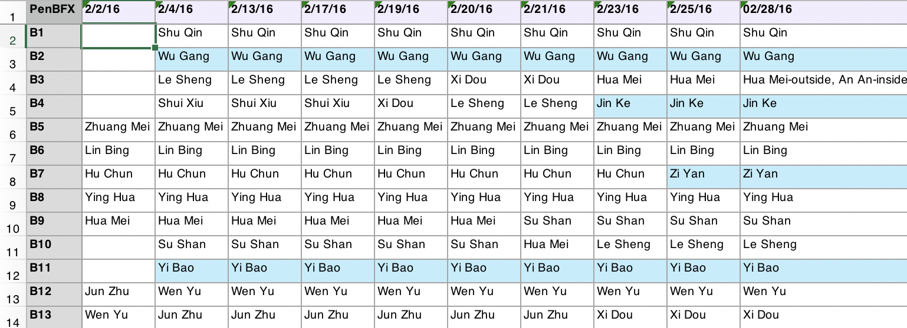
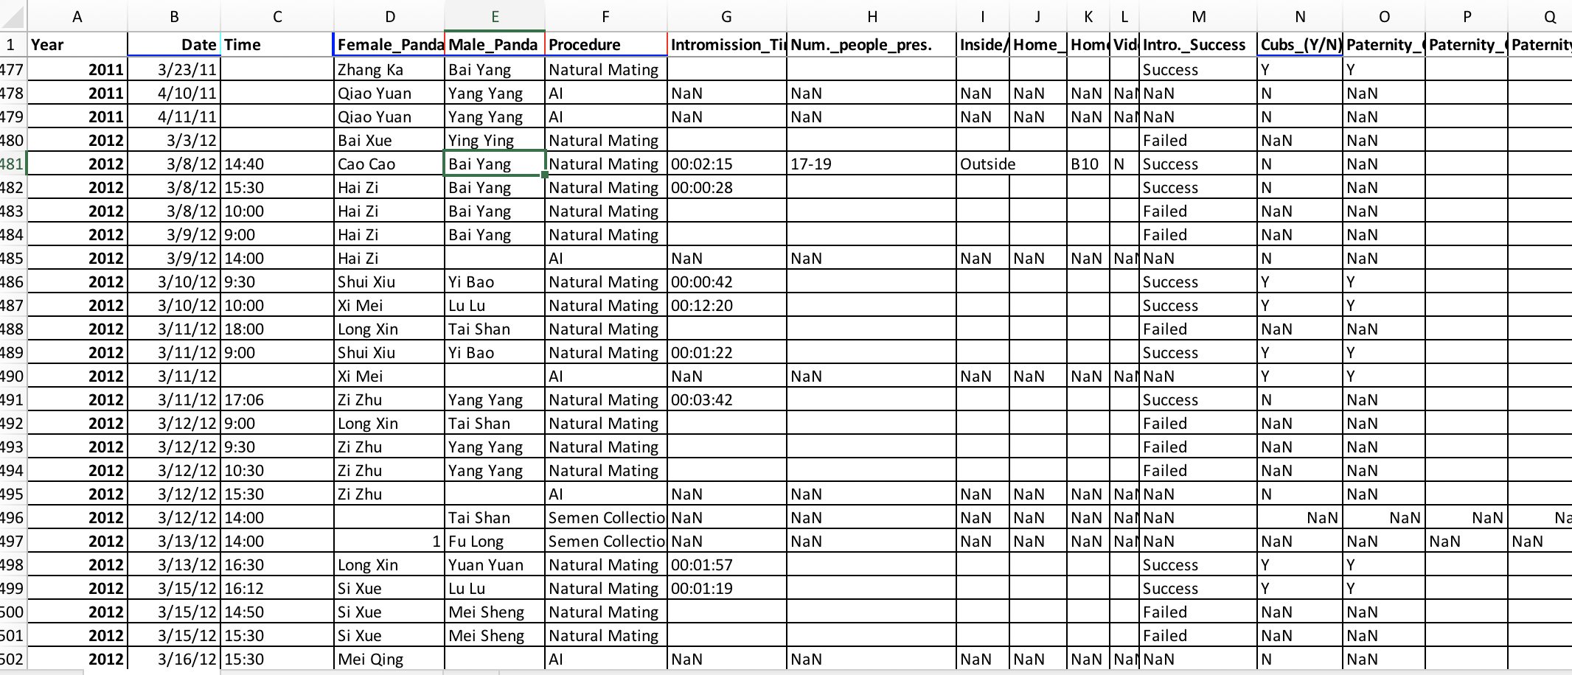
Location information
Master Log of every breeding

Slide 13
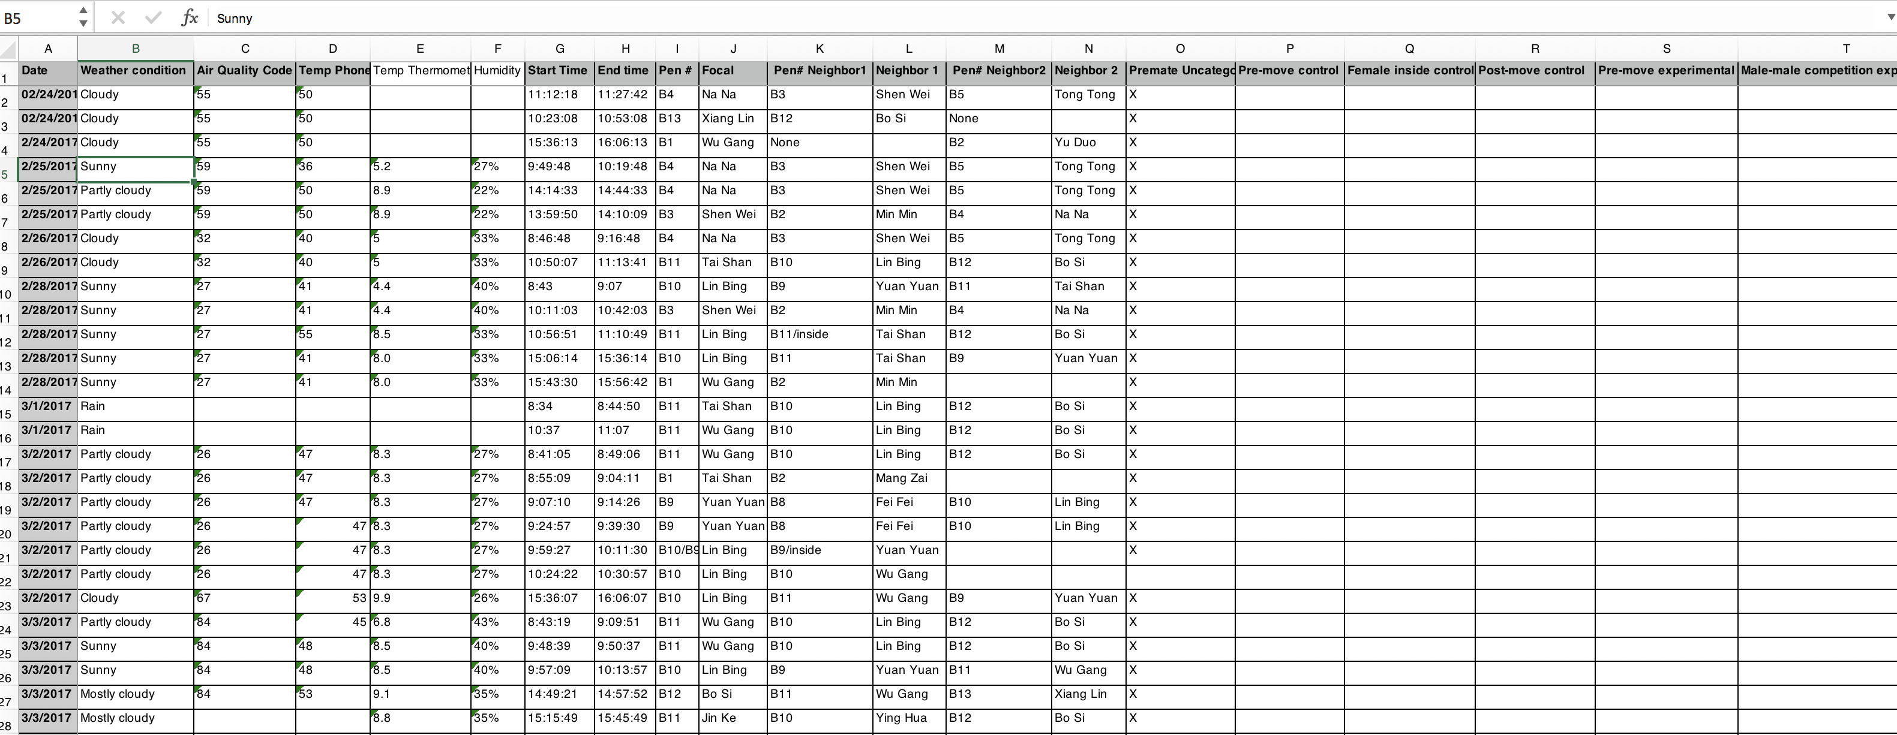
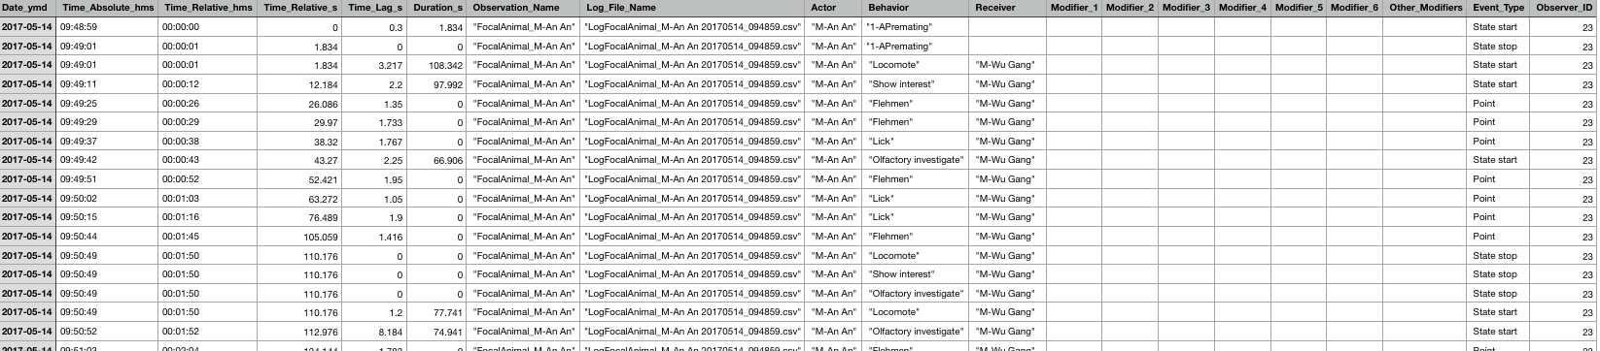
Behavioral Observation Log
Behavior Observation
Personality, mating, stereotype

Slide 14
What We Want
SQL type data base that can:
Have data input via an App on the ground that keepers and research staff could use to let us record real time husbandry information (pen switches, vet records, weight records, hormone data, etc.)
Have behavior recording app observations in database
Pull iPad behavior recordings, studbook info, environmental parameters, and husbandry records based on animal IDs to a final excel file for analysis

Slide 15
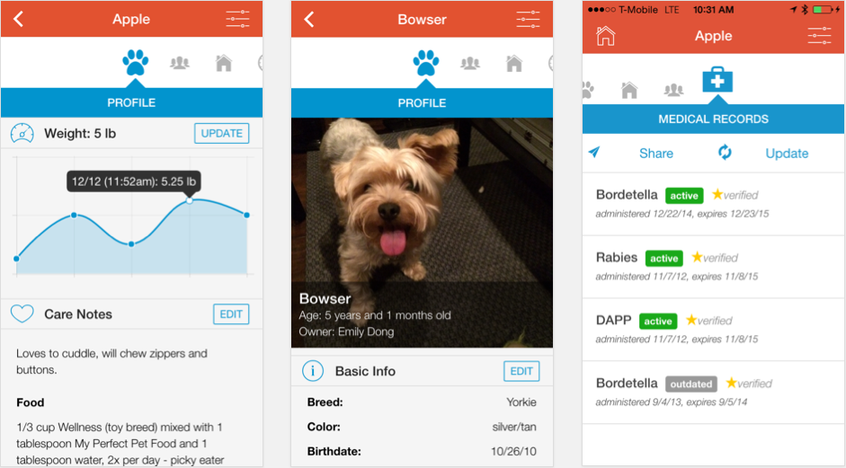
Keeper App
Select record type
Weights, Hormone, Location Change, Cub birth, Mating Attempt, etc.
Pair with Studbook ID info and general history

Slide 16
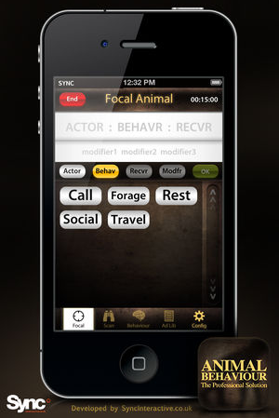
Summarize & Sync Behavior App
Animal Behaviour Pro App
Summarize behaviors into frequency and duration

Slide 17
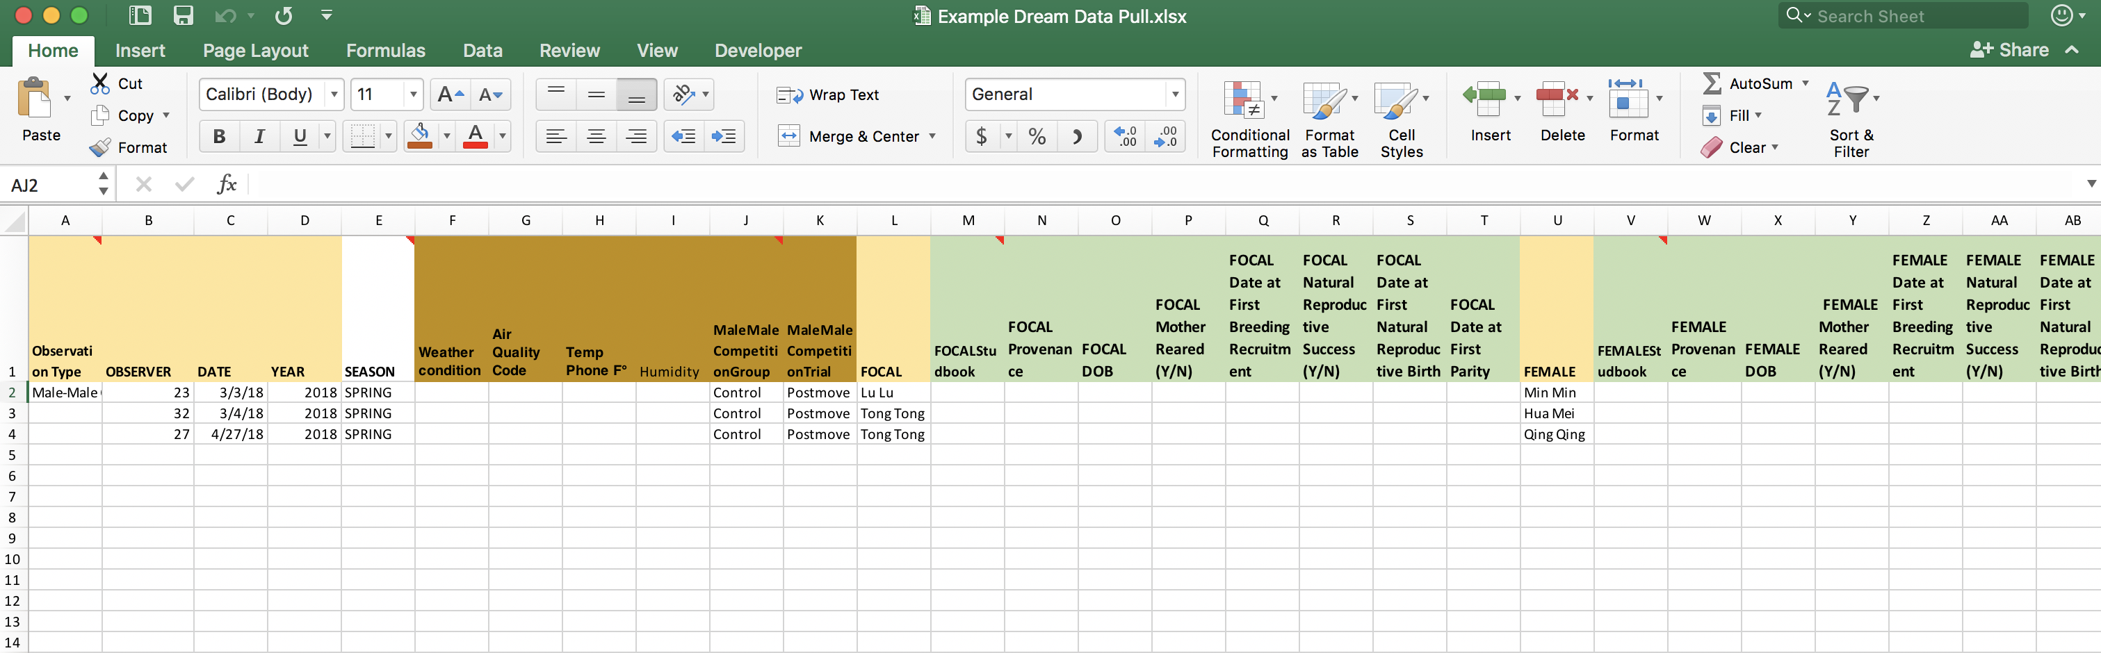
Pull Behav Observation & GP Data
Pull by observation records and sync all other pertinent info
Closest weight, closest hormone, closest vet record, etc.

